Slide 1
CS4961 Parallel Programming
Lecture 10:
Introduction to SIMD
Mary Hall
September 27, 2011
09/27/2011
CS4961

Slide 2
Today’s Lecture
Conceptual understanding of SIMD
Practical understanding of SIMD in the context of multimedia extensions
Slide source:
  Sam Larsen, PLDI 2000, http://people.csail.mit.edu/slarsen/
09/27/2011
CS4961

Slide 3
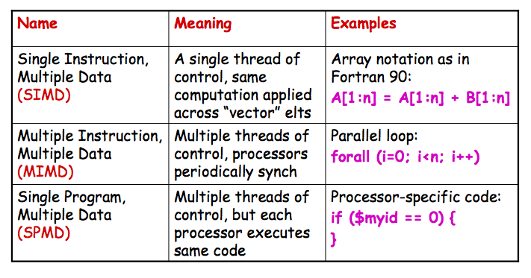
Review: Predominant Parallel Control Mechanisms
09/27/2011
CS4961

Slide 4
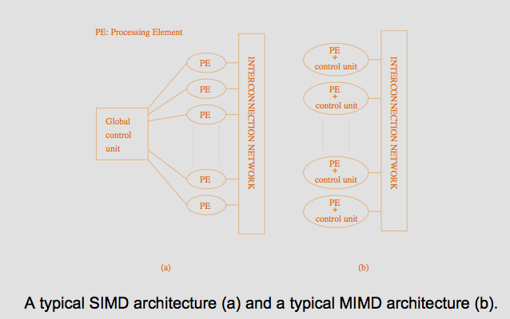
SIMD and MIMD Architectures:
What’s the Difference?
Slide source: Grama et al., Introduction to Parallel Computing, http://www.users.cs.umn.edu/~karypis/parbook
09/27/2011
CS4961

Slide 5
Overview of SIMD Programming
Vector architectures
Early examples of SIMD supercomputers
TODAY Mostly
  Multimedia extensions such as SSE and AltiVec
  Graphics and games processors (CUDA, stay tuned)
  Accelerators (e.g., ClearSpeed)
Is there a dominant SIMD programming model
  Unfortunately, NO!!!
Why not?
  Vector architectures were programmed by scientists
  Multimedia extension architectures are programmed by systems programmers (almost assembly language!)
  GPUs are programmed by games developers (domain- specific libraries)
09/27/2011
CS4961

Slide 6
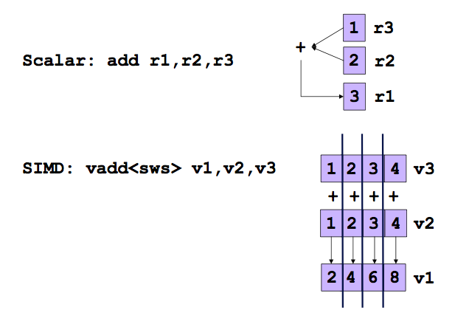

Scalar vs. SIMD in Multimedia Extensions
Slide source: Sam Larsen
09/27/2011
CS4961

Slide 7
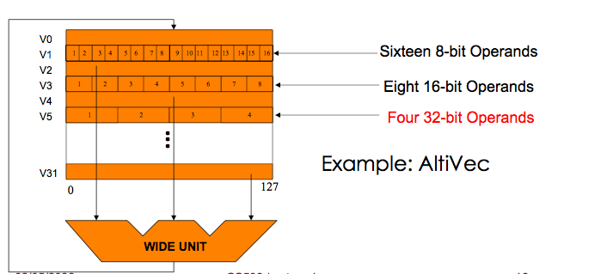
Multimedia Extension Architectures
At the core of multimedia extensions
  SIMD parallelism
  Variable-sized data fields:
  Vector length = register width / type size
Slide source: Jaewook Shin
09/27/2011
CS4961

Slide 8
Multimedia / Scientific Applications
Image
  Graphics : 3D games, movies
  Image recognition
  Video encoding/decoding : JPEG, MPEG4
Sound
  Encoding/decoding: IP phone, MP3
  Speech recognition
  Digital signal processing: Cell phones
Scientific applications
  Array-based data-parallel computation, another level of parallelism
09/27/2011
CS4961

Slide 9
Characteristics of Multimedia Applications
Regular data access pattern
  Data items are contiguous in memory
Short data types
  8, 16, 32 bits
Data streaming through a series of processing stages
  Some temporal reuse for such data streams
Sometimes …
  Many constants
  Short iteration counts
  Requires saturation arithmetic
09/27/2011
CS4961

Slide 10
Why SIMD
+More parallelism
+When parallelism is abundant
+SIMD in addition to ILP
+Simple design
+Replicated functional units
+Small die area
+No heavily ported register files
+Die area: +MAX-2(HP): 0.1% +VIS(Sun): 3.0%
-Must be explicitly exposed to the hardware
-By the compiler or by the programmer
09/27/2011
CS4961

Slide 11
Programming Multimedia Extensions
Language extension
  Programming interface similar to function call
  C: built-in functions, Fortran: intrinsics
  Most native compilers support their own multimedia extensions
    GCC: -faltivec, -msse2
    AltiVec: dst= vec_add(src1, src2);
    SSE2: dst= _mm_add_ps(src1, src2);
    BG/L: dst= __fpadd(src1, src2);
    No Standard !
09/27/2011
CS4961

Slide 12
Rest of Lecture
Understanding multimedia execution
Understanding the overheads
Understanding how to write code to deal with the overheads
Note:
A few people write very low-level code to access this capability.
Today the compilers do a pretty good job, at least on relatively simple codes.
09/27/2011
CS4961

Slide 13
Exploiting SLP with SIMD Execution
Benefit:
  Multiple ALU ops → One SIMD op
  Multiple ld/st ops → One wide mem op
What are the overheads:
  Packing and unpacking:
    rearrange data so that it is contiguous
  Alignment overhead
    Accessing data from the memory system so that it is aligned to a “superword” boundary
  Control flow
    Control flow may require executing all paths
09/27/2011
CS4961

Slide 14
1. Independent ALU Ops
R = R + XR * 1.08327
G = G + XG * 1.89234
B = B + XB * 1.29835
R R XR 1.08327
G = G + XG * 1.89234
B B XB 1.29835
Slide source: Sam Larsen
09/27/2011
CS4961

Slide 15
2. Adjacent Memory References
R = R + X[i+0]
G = G + X[i+1]
B = B + X[i+2]
R R
G = G + X[i:i+2]
B B
Slide source: Sam Larsen
09/27/2011
CS4961

Slide 16
3. Vectorizable Loops
for (i=0; i<100; i+=1)
A[i+0] = A[i+0] + B[i+0]
Slide source: Sam Larsen
09/27/2011
CS4961

Slide 17
3. Vectorizable Loops
for (i=0; i<100; i+=4)
A[i+0] = A[i+0] + B[i+0]
A[i+1] = A[i+1] + B[i+1]
A[i+2] = A[i+2] + B[i+2]
A[i+3] = A[i+3] + B[i+3]
for (i=0; i<100; i+=4)
A[i:i+3] = B[i:i+3] + C[i:i+3]
Slide source: Sam Larsen
09/27/2011
CS4961

Slide 18
4. Partially Vectorizable Loops
for (i=0; i<16; i+=1)
L = A[i+0] – B[i+0]
D = D + abs(L)
Slide source: Sam Larsen
09/27/2011
CS4961

Slide 19
4. Partially Vectorizable Loops
for (i=0; i<16; i+=2)
L = A[i+0] – B[i+0]
D = D + abs(L)
L = A[i+1] – B[i+1]
D = D + abs(L)
for (i=0; i<16; i+=2)
L0
L1
= A[i:i+1] – B[i:i+1]
D = D + abs(L0)
D = D + abs(L1)
Slide source: Sam Larsen
09/27/2011
CS4961

Slide 20
Programming Complexity Issues
High level: Use compiler
  may not always be successful
Low level: Use intrinsics or inline assembly tedious and error prone
Data must be aligned,and adjacent in memory
  Unaligned data may produce incorrect results
  May need to copy to get adjacency (overhead)
Control flow introduces complexity and inefficiency
Exceptions may be masked
09/27/2011
CS4961

Slide 21
Packing/Unpacking Costs
C = A + 2
D = B + 3
C A 2
D B 3
= +
Slide source: Sam Larsen
09/27/2011
CS4961

Slide 22
Packing/Unpacking Costs
Packing source operands
  Copying into contiguous memory
A A
A = f()
B = g()
B B
C = A + 2
D = B + 3
C A 2
D B 3
= +
09/27/2011
CS4961

Slide 23
Packing/Unpacking Costs
Packing source operands
  Copying into contiguous memory
Unpacking destination operands
  Copying back to location
A A
A = f()
B = g()
B B
C = A + 2
D = B + 3
C A 2
D B 3
= +
E = C / 5
F = D * 7
C C
D D
Slide source: Sam Larsen
09/27/2011
CS4961

Slide 24
Alignment Code Generation
Aligned memory access
  The address is always a multiple of 16 bytes
  Just one superword load or store instruction
float a[64];
for (i=0; i<64; i+=4)
Va = a[i:i+3];
0
16
32
48
…
09/27/2011
CS4961

Slide 25
Alignment Code Generation (cont.)
Misaligned memory access
  The address is always a non-zero constant offset away from the 16 byte boundaries.
  Static alignment: For a misaligned load, issue two adjacent aligned loads followed by a merge.
float a[64];
for (i=0; i<60; i+=4)
Va = a[i+2:i+5];
float a[64];
for (i=0; i<60; i+=4)
V1 = a[i:i+3];
V2 = a[i+4:i+7];
Va = merge(V1, V2, 8);
0
16
32
48
…
09/27/2011
CS4961

Slide 26
Statically align loop iterations
float a[64];
for (i=0; i<60; i+=4)
Va = a[i+2:i+5];
float a[64];
Sa2 = a[2]; Sa3 = a[3];
for (i=2; i<62; i+=4)
Va = a[i:i+3];
09/27/2011
CS4961

Slide 27
Alignment Code Generation (cont.)
Unaligned memory access
  The offset from 16 byte boundaries is varying or not enough information is available.
  Dynamic alignment: The merging point is computed during run time.
float a[64];
start = read();
for (i=start; i<60; i++)
Va = a[i:i+3];
float a[64];
start = read();
for (i=start; i<60; i++)
V1 = a[i:i+3];
V2 = a[i+4:i+7];
align = (&a[i:i+3])%16;
Va = merge(V1, V2, align);
09/27/2011
CS4961

Slide 28
Summary of dealing with alignment issues
Worst case is dynamic alignment based on address calculation (previous slide)
Compiler (or programmer) can use analysis to prove data is already aligned
  We know that data is initially aligned at its starting address by convention
  If we are stepping through a loop with a constant starting point and accessing the data sequentially, then it preserves the alignment across the loop
We can adjust computation to make it aligned by having a sequential portion until aligned, followed by a SIMD portion, possibly followed by a sequential cleanup
Sometimes alignment overhead is so significant that there is no performance gain from SIMD execution
09/29/2011
CS4961

Slide 29
Last SIMD issue: Control Flow
What if I have control flow?
  Both control flow paths must be executed!
What happens:
Compute a[i] !=0 for all fields
Compare b[i]++ for all fields in temporary t1
Copy b[i] into another register t2
Merge t1 and t2 according to value of a[i]!=0
for (i=0; i<16; i++)
if (a[i] != 0)
b[i]++;
What happens:
Compute a[i] !=0 for all fields
Compute b[i] = b[i]/a[i] in register t1
Compare b[i]++ for all fields in t2
Merge t1 and t2 according to value of a[i]!=0
for (i=0; i<16; i++)
if (a[i] != 0)
b[i] = b[i] / a[i];
else
b[i]++;
09/29/2011
CS4961

Slide 30
SIMD Example
for (i=0; i<16; i++)
if (a[i] != 0)
b[i]++;
for (i=0; i<16; i+=4){
pred = a[i:i+3] != (0, 0, 0, 0);
old = b[i:i+3];
new = old + (1, 1, 1, 1);
b[i:i+3] = SELECT(old, new, pred);
}
Overhead:
Both control flow paths are always executed !
09/16/2010
CS4961

Slide 31
Can we improve on this?
Suppose that all control flow paths are not executed with the same frequency
Code could be optimized for the one with the highest frequency
The other would execute with the default general behavior
for (i=0; i<16; i++)
if (a[i] != 0)
b[i]++;
What if a is usually 0:
Compute a[i] !=0 for all fields
Use general code when some fields
are nonzero
Otherwise do nothing
09/29/2011
CS4961

Slide 32
An Optimization:
Branch-On-Superword-Condition-Code
for (i=0; i<16; i+=4){
pred = a[i:i+3] != (0, 0, 0, 0);
branch-on-none(pred) L1;
old = b[i:i+3];
new = old + (1, 1, 1, 1);
b[i:i+3] = SELECT(old, new, pred);
L1:
}
09/16/2010
CS4961

Slide 33
Control Flow
Not likely to be supported in today’s commercial compilers
  Increases complexity of compiler
  Potential for slowdown
  Performance is dependent on input data
Many are of the opinion that SIMD is not a good programming model when there is control flow.
But speedups are possible!
09/16/2010
CS4961

Slide 34
Nuts and Bolts
What does a piece of code really look like?
for (i=0; i<100; i+=4)
A[i:i+3] = B[i:i+3] + C[i:i+3]
for (i=0; i<100; i+=4) {
__m128 btmp = _mm_load_ps(float B[I]);
__m128 ctmp = _mm_load_ps(float C[I]);
__m128 atmp = _mm_add_ps(__m128 btmp, __m128 ctmp);
void_mm_store_ps(float A[I], __m128 atmp);
}
09/16/2010
CS4961

Slide 35
Wouldn’t you rather use a compiler?
Intel compiler is pretty good
  icc –msse3 –vecreport3 <file.c>
Get feedback on why loops were not “vectorized”
Water has its own SIMD extension,
09/16/2010
CS4961

